Slide 1
Linux
History
Usage
Design
Hardware
so on….
Md. Sharafat Karim
#2102024

Slide 2
Contents
History
Design
Development
Hardware support
Uses
Market share and uptake
Copyright, trademark, and naming

Slide 3

INTRO
What is it?
Linux (/ˈlɪnʊks/ LIN-uuks)^{[11]} is a family of open-source Unix-like operating systems based on the Linux kernel,^{[12]} an operating system kernel first released on September 17, 1991, by Linus Torvalds.^{[13][14][15]} Linux is typically packaged as a Linux distribution, which includes the kernel and supporting system software and libraries, many of which are provided by the GNU Project.
Notes:
Consider talking about:
Precursors
Creation
Naming
Commercial and popular uptake
Current development

Slide 4
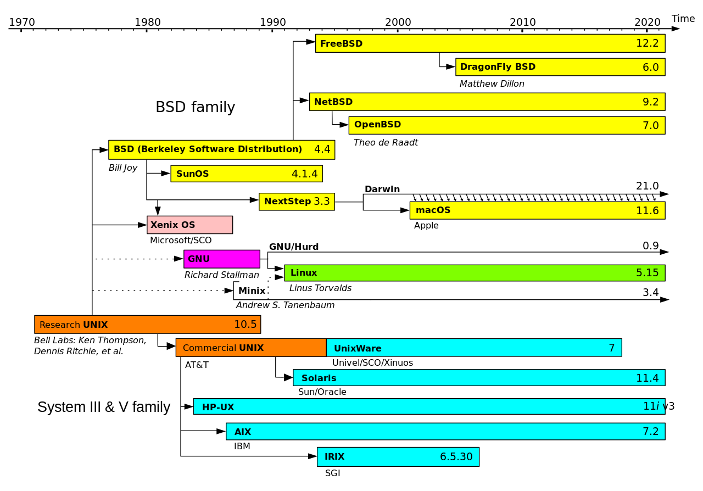
History
Notes:
Consider talking about:
Precursors
Creation
Naming
Commercial and popular uptake
Current development

Slide 5
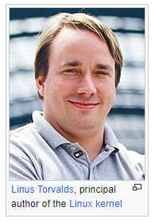
History
Linux was created in the early 1990s by Linus Torvalds, a Finnish software engineer who wanted to make a better system than MINIX, a UNIX-based operating system for education¹². He started developing Linux as a personal project while he was a student at the University of Helsinki³. He released the first version of the Linux kernel in 1991 and made it available for free under the GNU General Public License (GPL)². Since then, Linux has grown into a popular and widely used operating system with many contributors and distributions³. Linus Torvalds is still the leader of the Linux kernel development and one of the world’s top innovators⁴⁵. He lives in Portland, Oregon, USA⁵.

Slide 6

Design
Best Beautiful Linux Distributions?
Wait! Is there a thing called a beautiful Linux distribution? Is it not redundant considering the fact that you can customize the look of any distribution and make it look better with themes and icons?
Notes:
Consider talking about:
User interface
Video input infrastructure

Slide 7
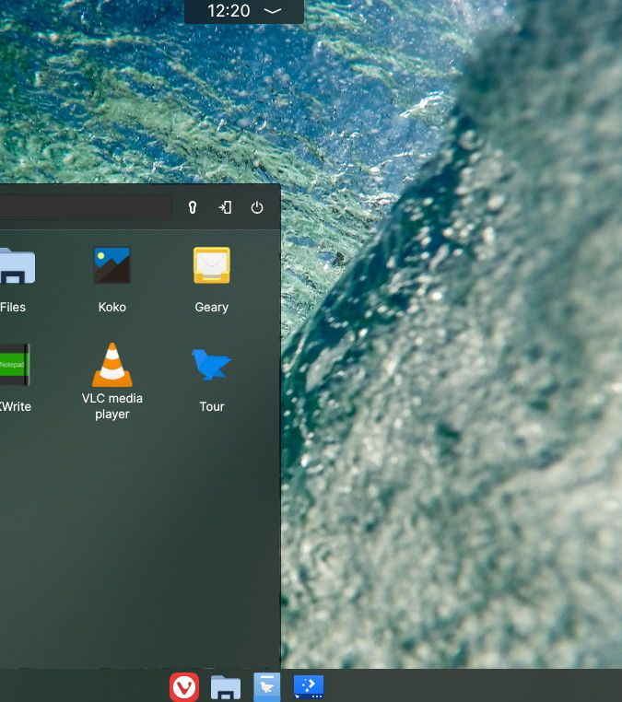
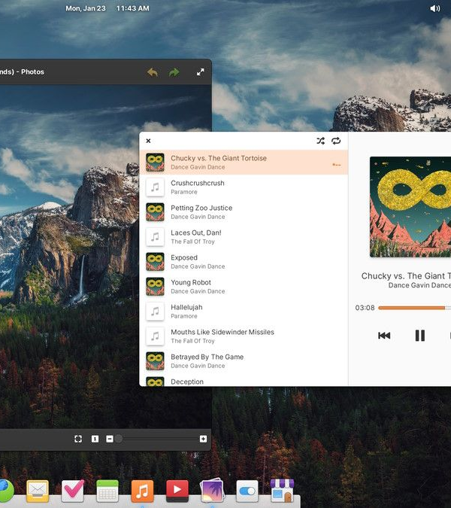
Design
Notes:
Consider talking about:
User interface
Video input infrastructure

Slide 8
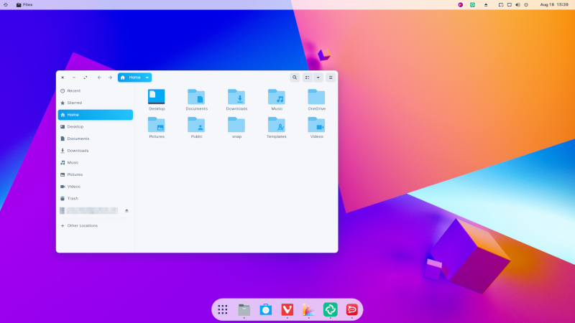
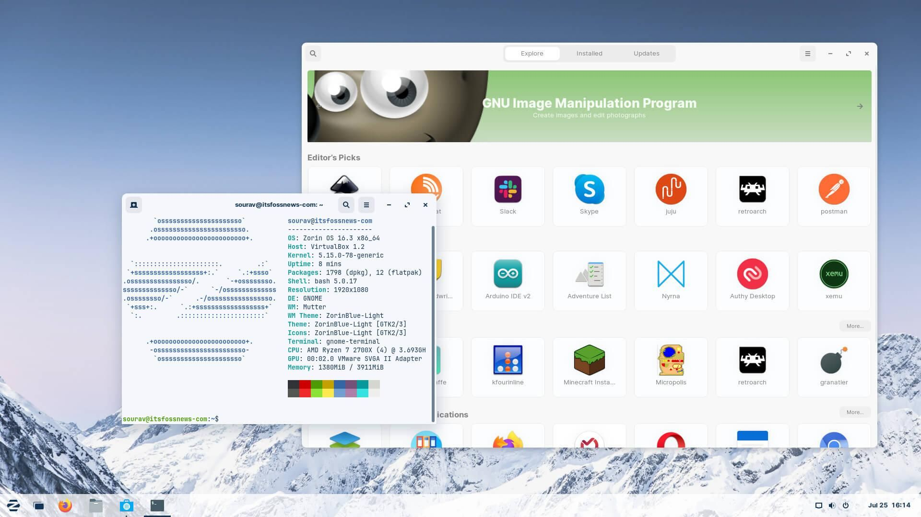
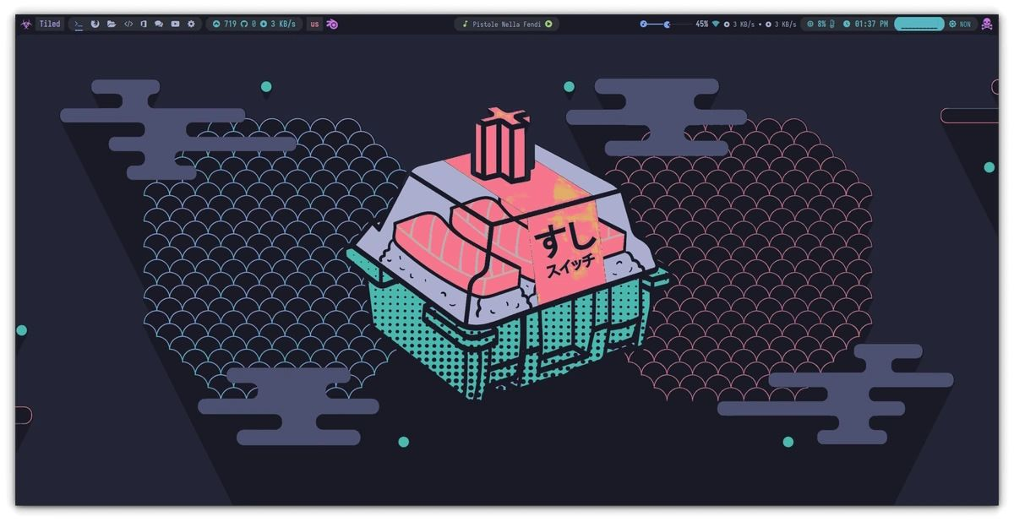
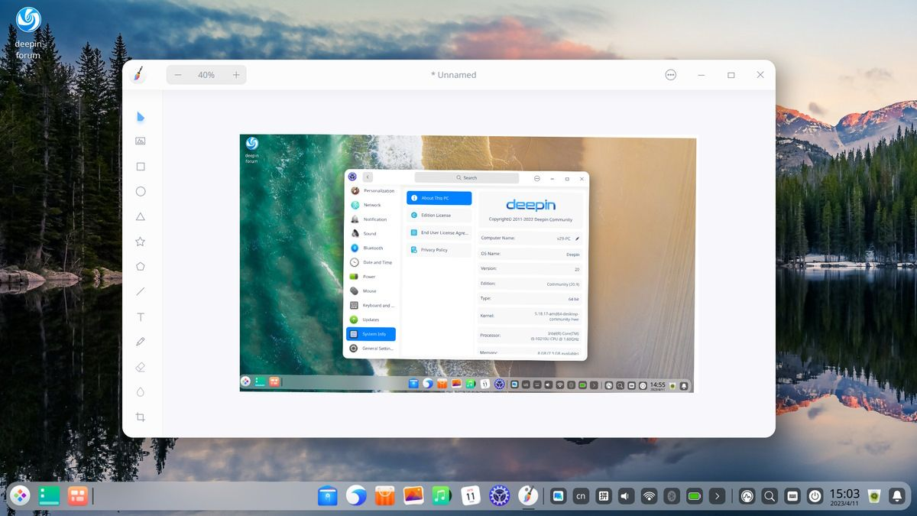
Design
Notes:
Consider talking about:
User interface
Video input infrastructure

Slide 9
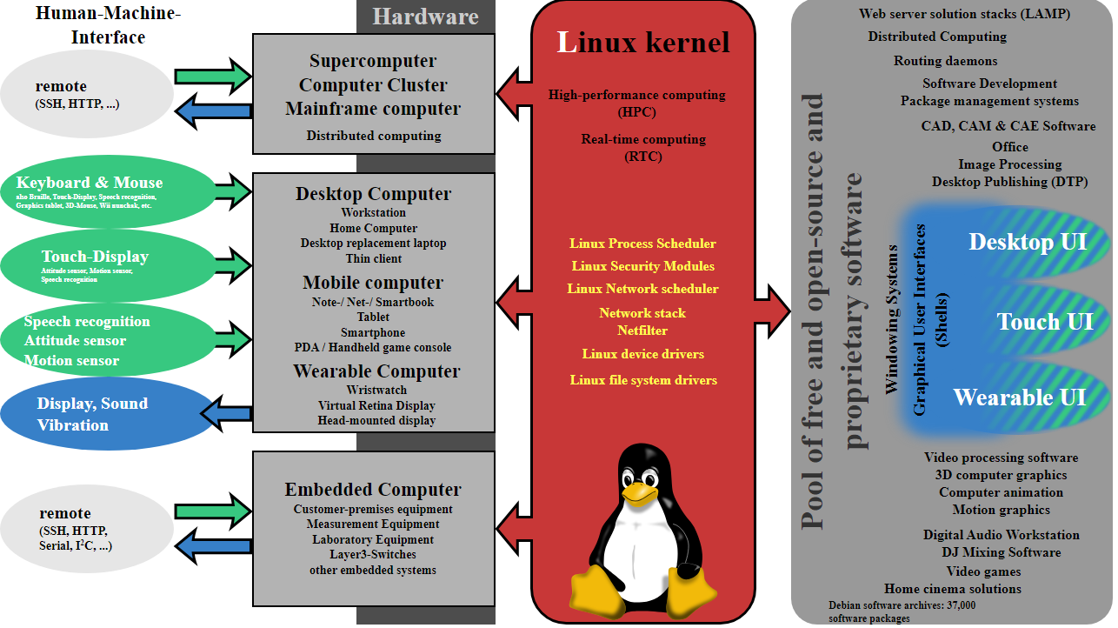
Development
A Linux distribution is usually built around a package management system, which puts together the Linux kernel, free and open-source software, and occasionally some proprietary software.
Notes:
Consider talking about:
Community
Programming on Linux

Slide 10

Hardware support
Linux can run on most PCs with a 64-bit Intel or AMD processor, but some hardware may require special attention or drivers¹²³.
You can check the Linux Hardware Database⁴ or the Ubuntu Certified catalogue⁵ to see if your hardware is compatible with Linux.
You can also build your own PC for Linux with components that are known to work well with Linux, such as AMD Ryzen CPUs, Gigabyte or AsRock motherboards, Corsair or Patriot RAM, AMD Radeon graphics cards, Western Digital or Samsung SSDs, Fractal or Cougar cases, and EVGA or Gigabyte power supplies⁶.

Slide 11
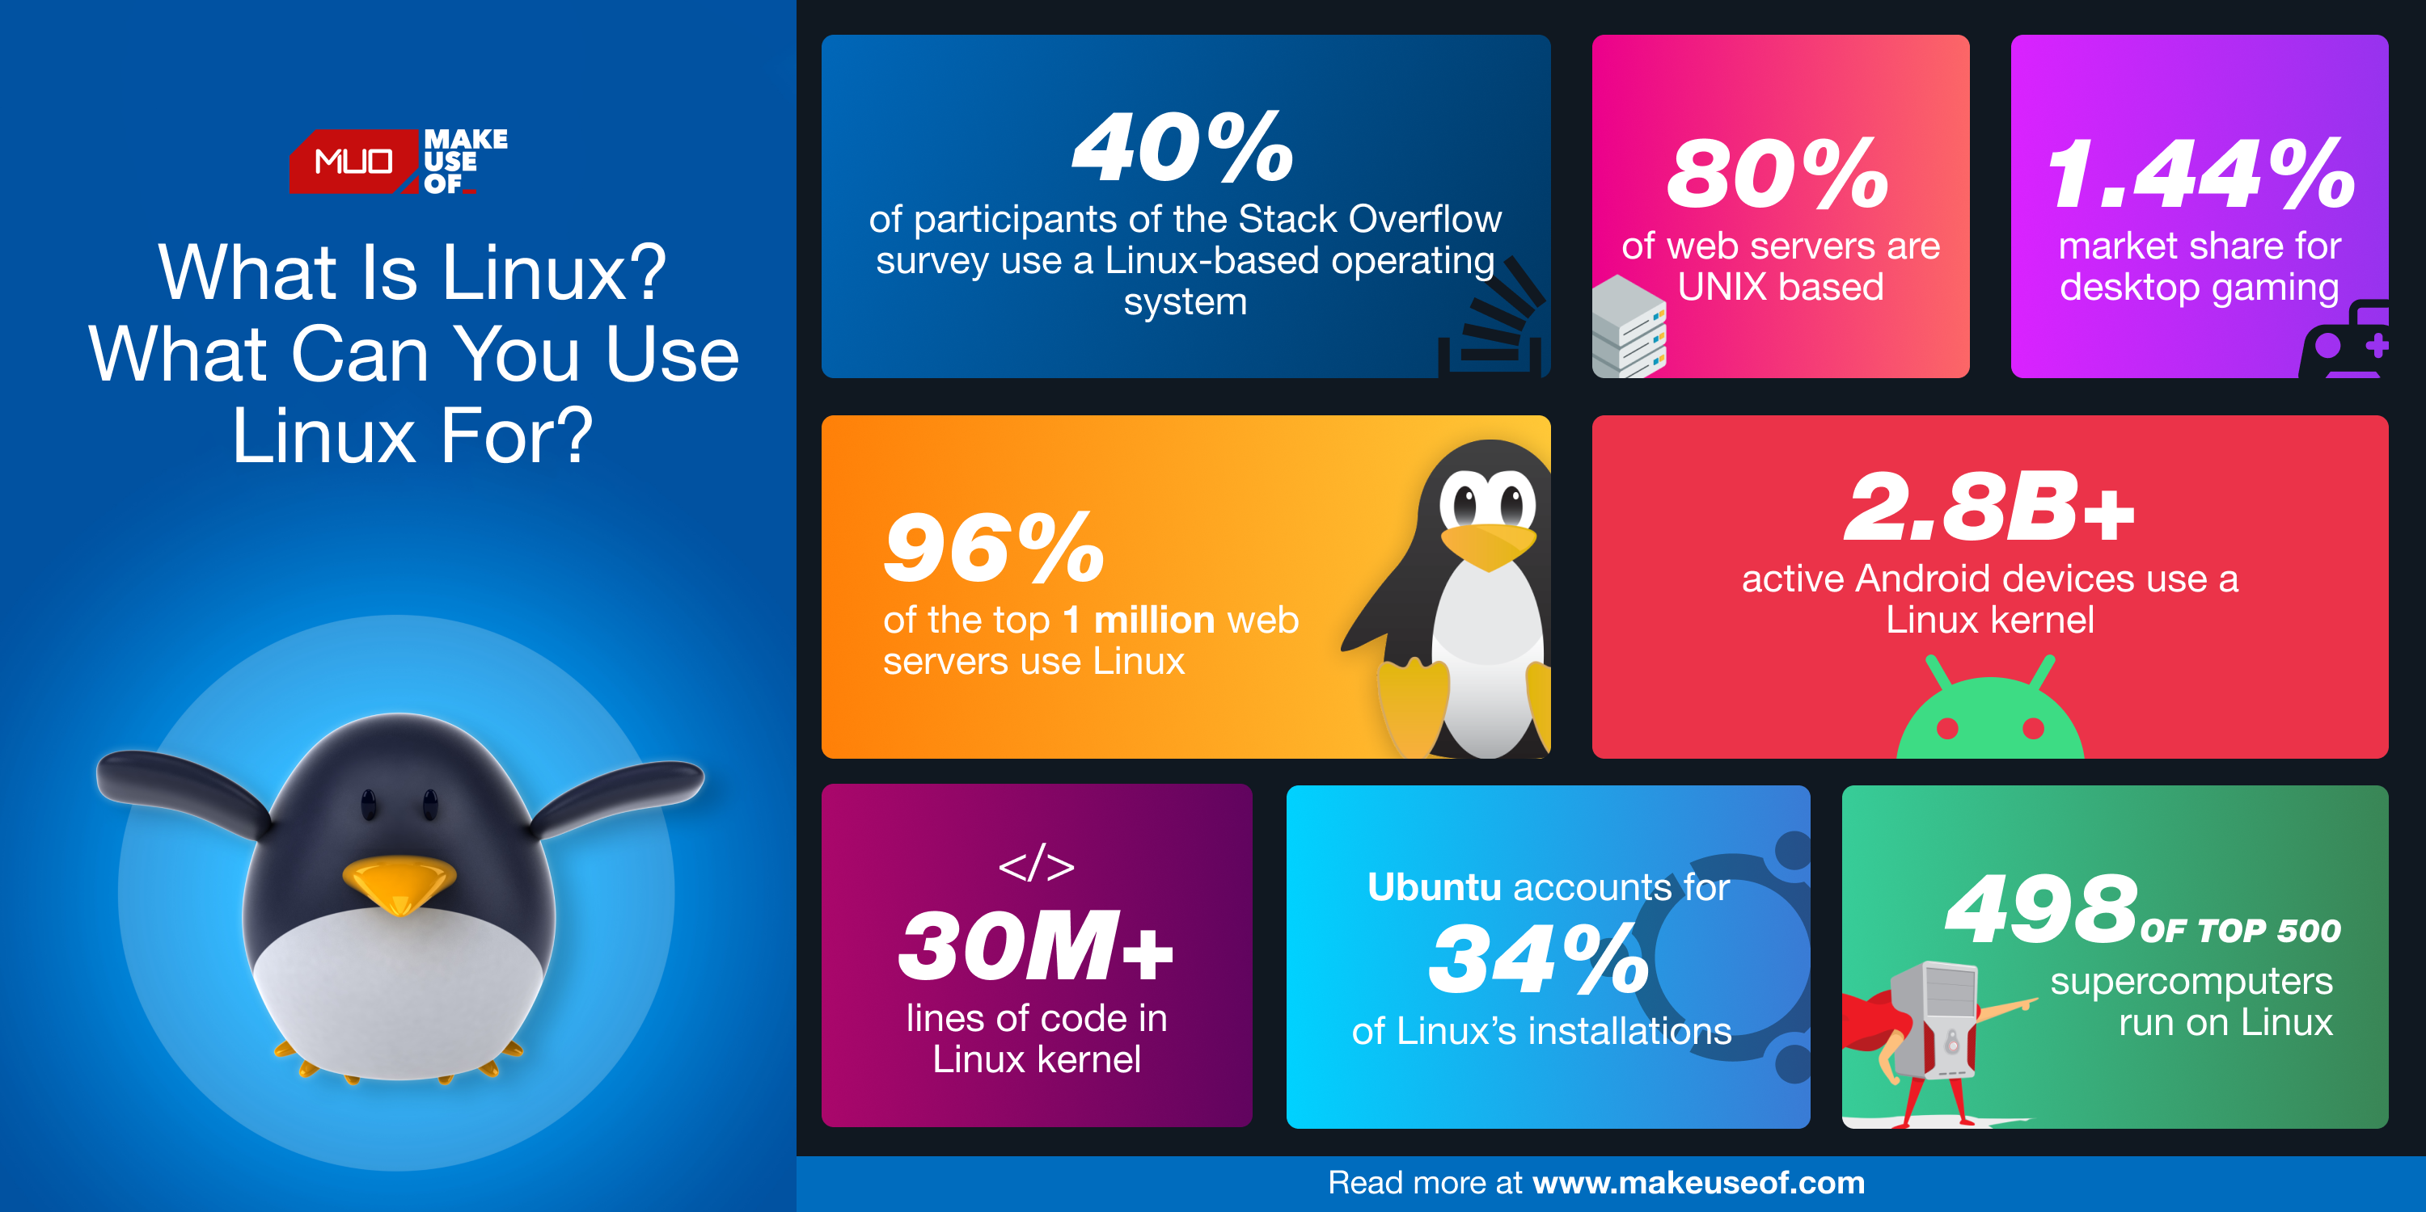
Uses
Notes:
Consider talking about:
Desktop
Netbooks
Servers, mainframes and supercomputers
Smart devices
Embedded devices
Gaming
Specialized uses

Slide 12
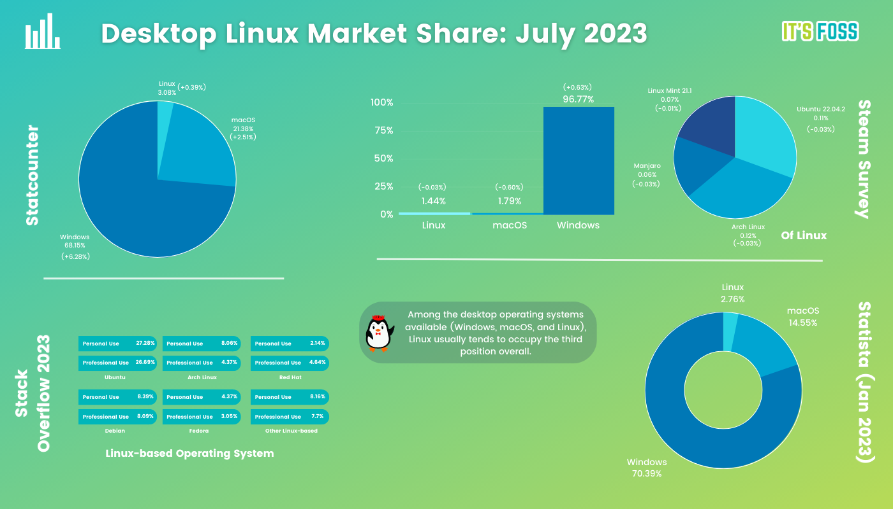
Market share and uptake

Slide 13

Copyright, trademark, and naming
UNIX is a trademark of Univel. Linux is a trademark of Linus Torvalds, and has no connection to UNIXTM or Univel.
Copyright © 1996,1997,1998,1999 David A Rusling 3 Foxglove Close, Wokingham, Berkshire RG41 3NF, UK david.rusling@arm.com

Slide 14

Works cited
Linux – Wikipedia
It's FOSS (itsfoss.com)
Linux | MUO (makeuseof.com)

Slide 15
Thanks for watching
Presented to you by
Sharafat Karim

